Slide 1

Olympic Insights: Analyzing Global Participation and Medal Achievements
Done by
Narmatha P

Slide 2

PROJECT OVERVIEW
Scope
Analyze Olympic participation and performance data to uncover trends, regional disparities, and the relationship between participation and medal outcomes.
Objectives:
Participation Trends: Identify top participating countries and analyze regional participation.
Medal Performance: Examine medal distributions and their relation to participation.
Regional Analysis: Explore regional patterns in Olympic success.
Statistical Testing: Use chi-square and t-tests to find significant relationships.
Visual Insights: Present findings through clear and engaging visualizations.

Slide 3

PROJECT DESCRIPTION
Participation Overview:
Identified the top countries by total participation in both Summer and Winter Olympics.
Analyzed the number of countries participating by region.
Medal Distribution:
Examined top-performing countries in terms of gold, silver, and bronze medals in Summer and Winter Games.
Analyzed countries with fewer than 10 total medals to understand underperformance.
Regional Analysis:
Explored regional variations in Olympic success, focusing on participation and medal counts by region.
Conducted chi-square tests to investigate the relationship between region and Winter Olympic participation.
Statistical Insights:
Performed a two-sample t-test to compare the distribution of medals in Summer and Winter Olympics.
Used visualizations like bar plots, pie charts, and violin plots to present data trends and patterns.
Special Focus:
Detailed analysis of India's performance, including a breakdown of its medal tally in the Summer Olympics.

Slide 4
DATA FEATURES
countries: Name of the Team (Country most often)
ioc_code: Code that "International Olympics Committee" (IOC) has assigned to each nation
summer_participation: Number of time team has participated in Summer Olympics
summer_gold: Number of golds team has won in all the summer Olympics combined
summer_silver: Number of silvers team has won in all the summer Olympics combined
summer_bronze: Number of bronzes team has won in all the summer Olympics combined
summer_total: Number of all the medals team has won in all the summer Olympics combined
winter_participation: Number of time team has participated in Winter Olympics
winter_gold: Number of golds team has won in all the Winter Olympics combined
winter_silver: Number of silvers team has won in all the Winter Olympics combined
winter_bronze: Number of bronzes team has won in all the Winter Olympics combined
winter_total: Number of all the medals team has won in all the Winter Olympics combined
total_participation: Number of time team has participated in summer & winter Olympics combined
total_gold: Number of golds team has won in all the summer and winter Olympics combined
total_silver: Number of silvers team has won in all the summer and winter Olympics combined
total_bronze: Number of bronzes team has won in all the summer and winter Olympics combined
total_total: Number of total medals team has won in all the summer and winter Olympics combined

Slide 5

SUMMER OLYMPICS

Slide 6
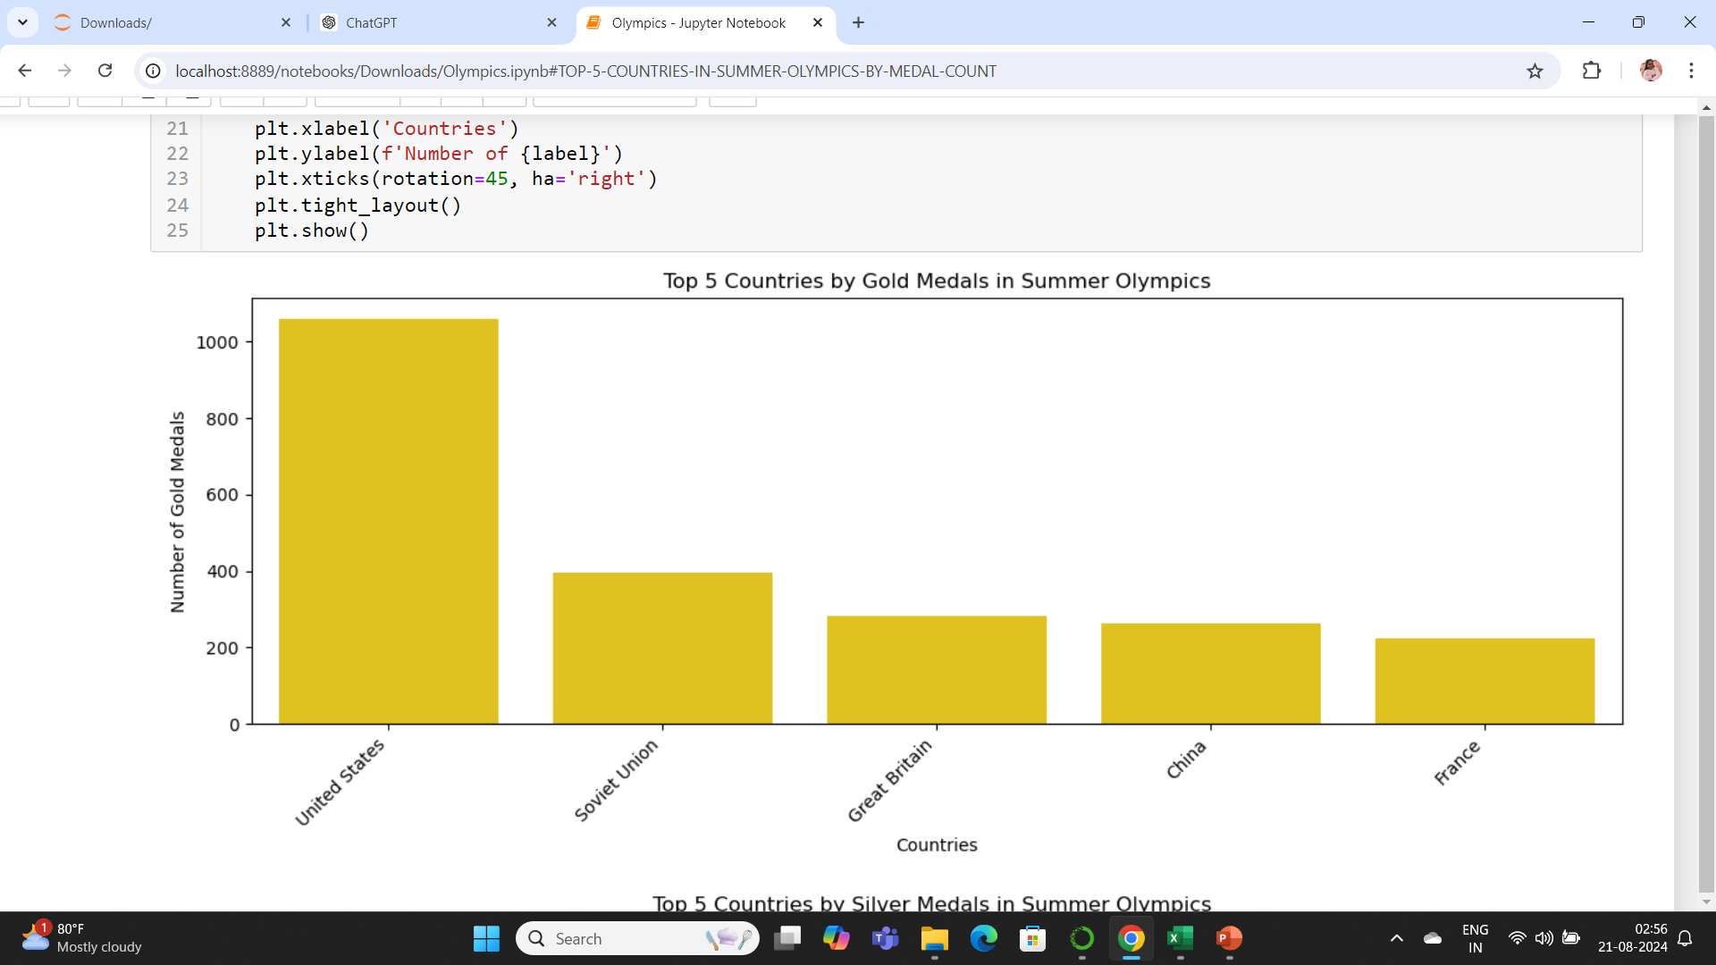

Slide 7
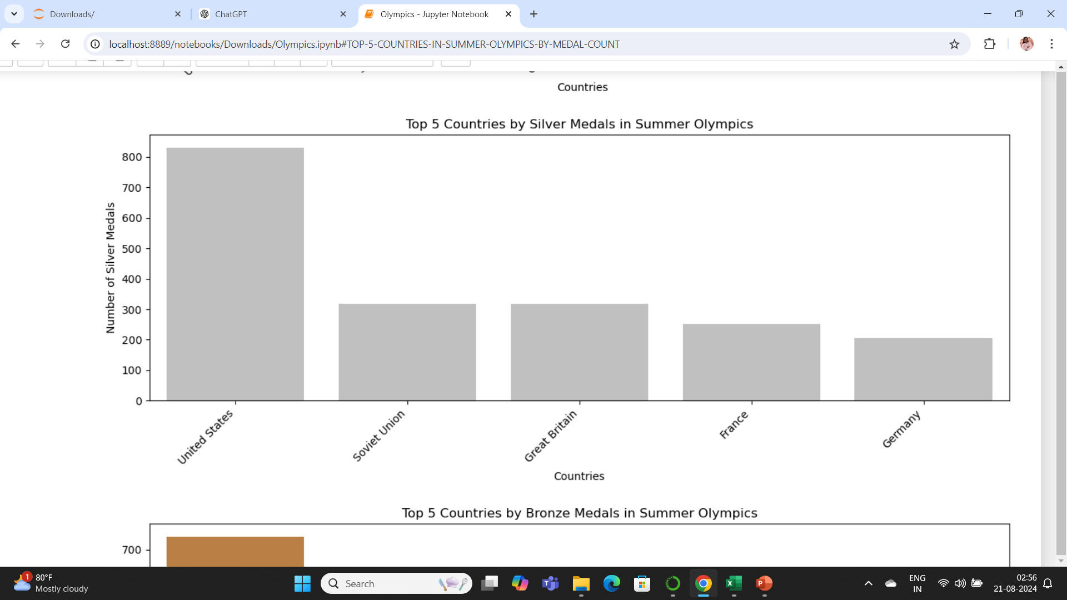

Slide 8
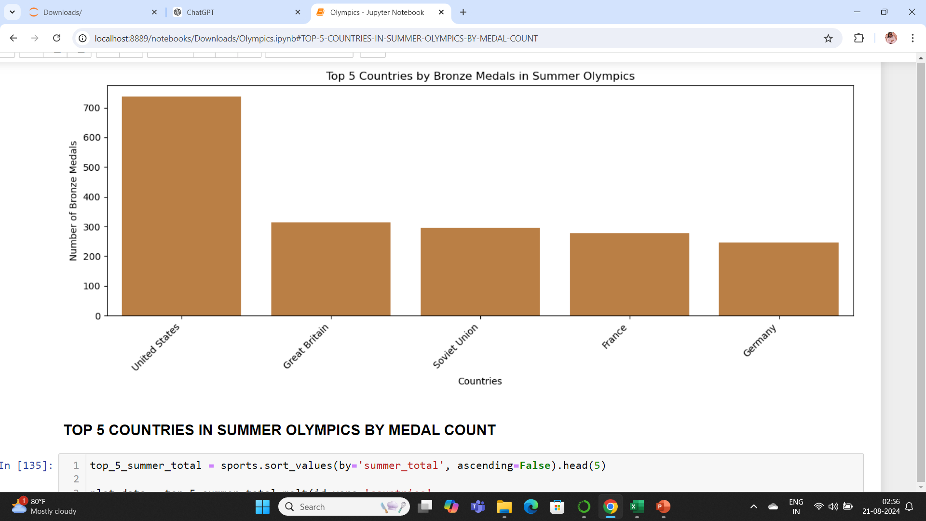

Slide 9
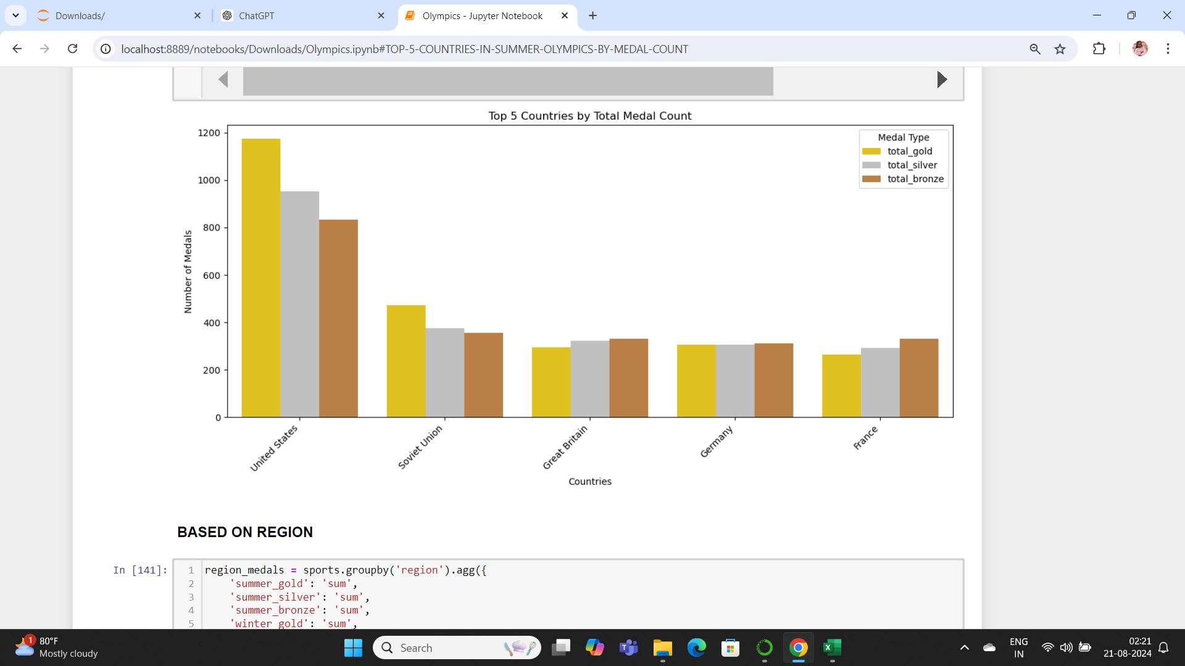
TOP 5 COUNTRIES IN SUMMER OLYMPICS

Slide 10
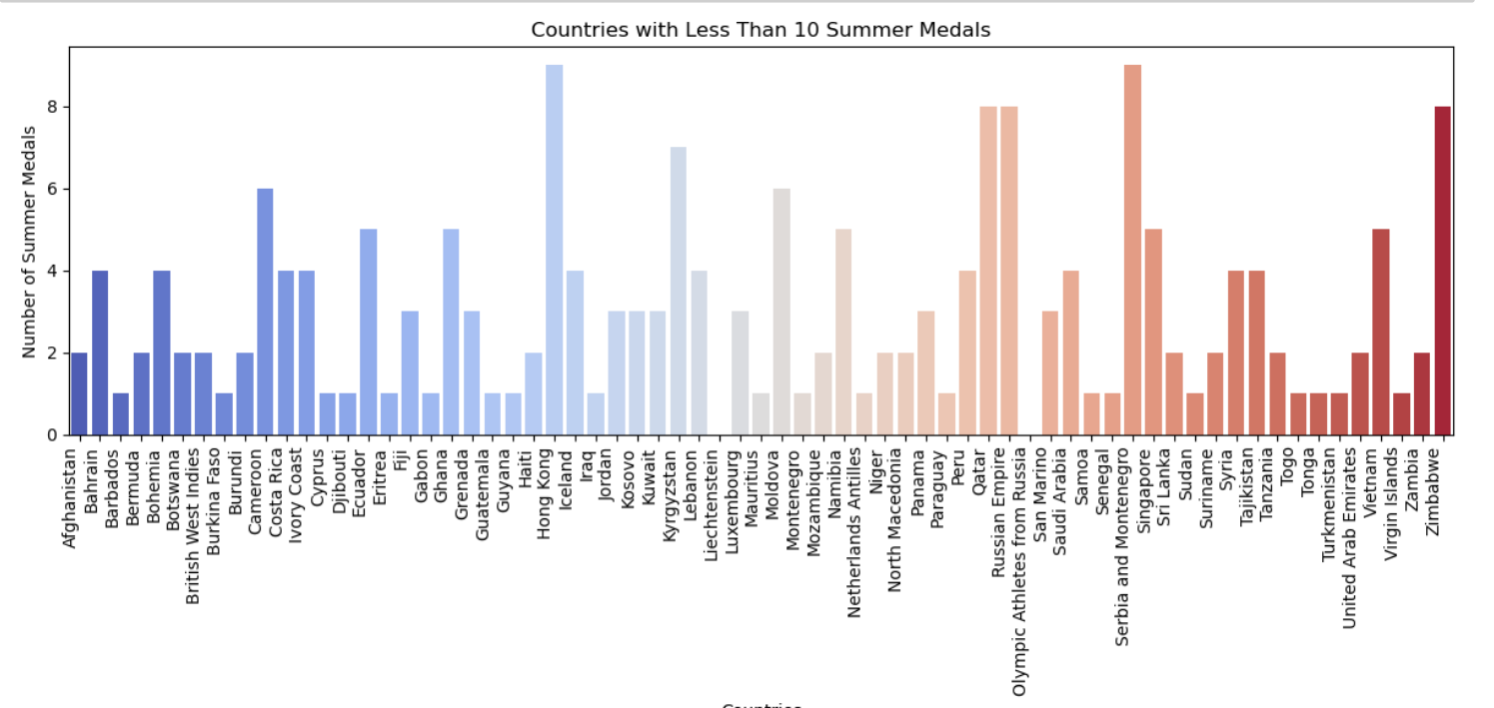
LOW PERFORMING COUNTRIES

Slide 11

WINTER OLYMPICS

Slide 12
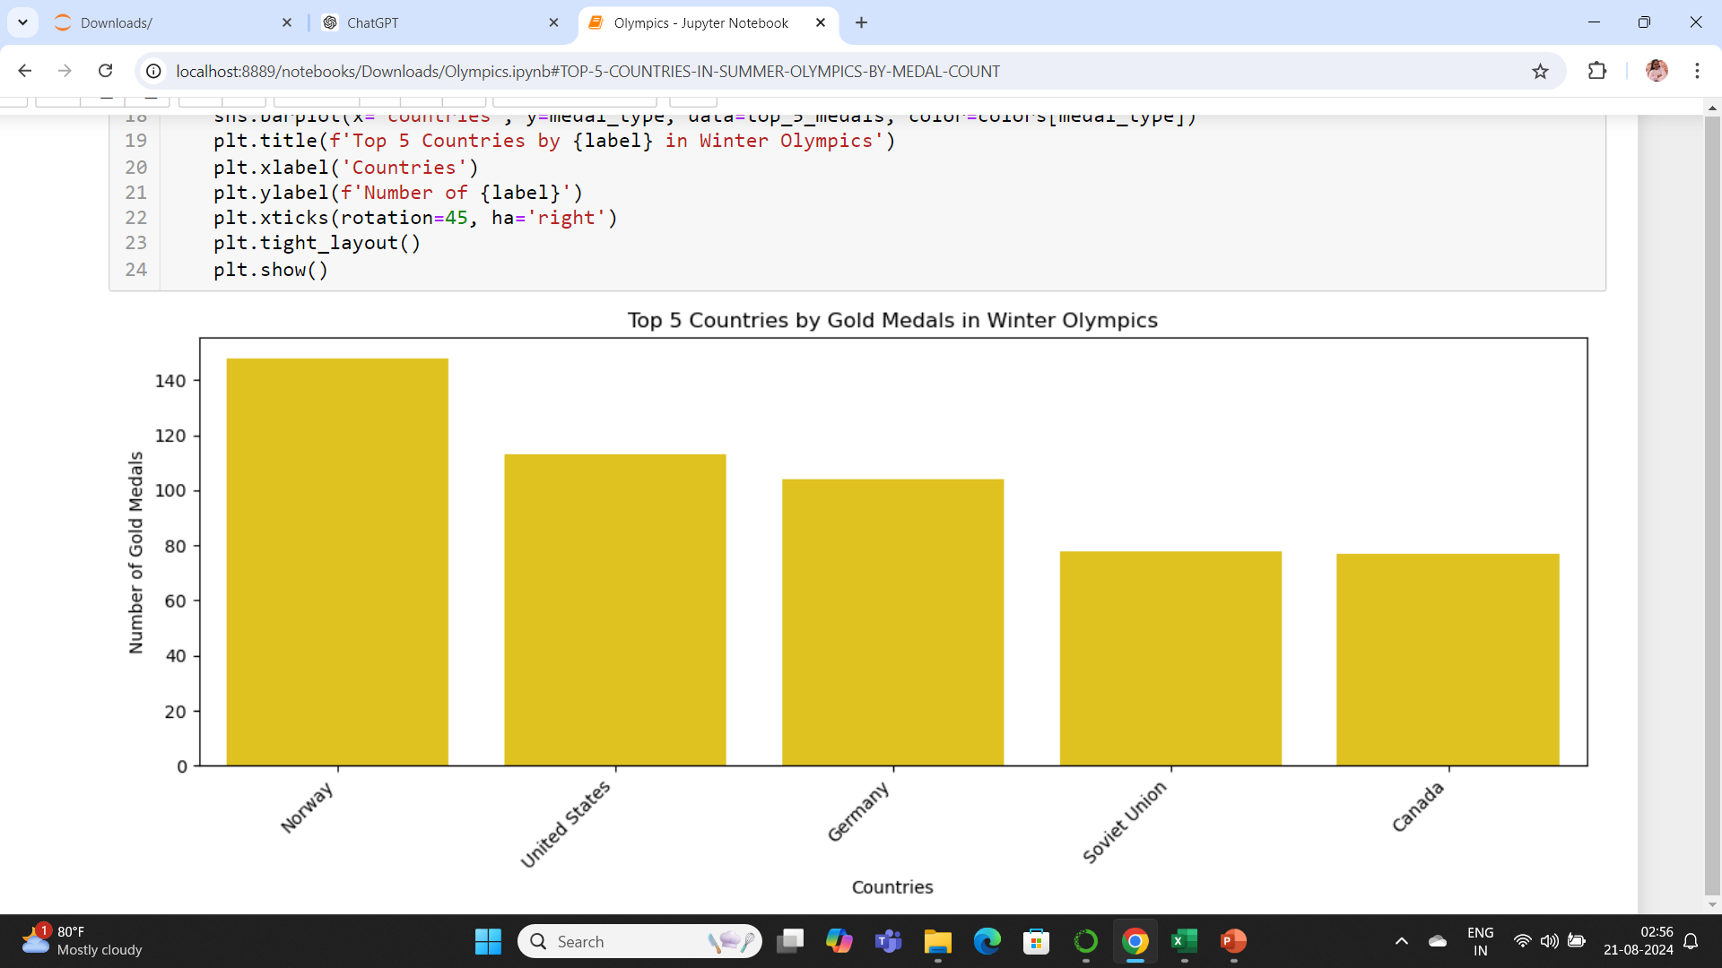

Slide 13
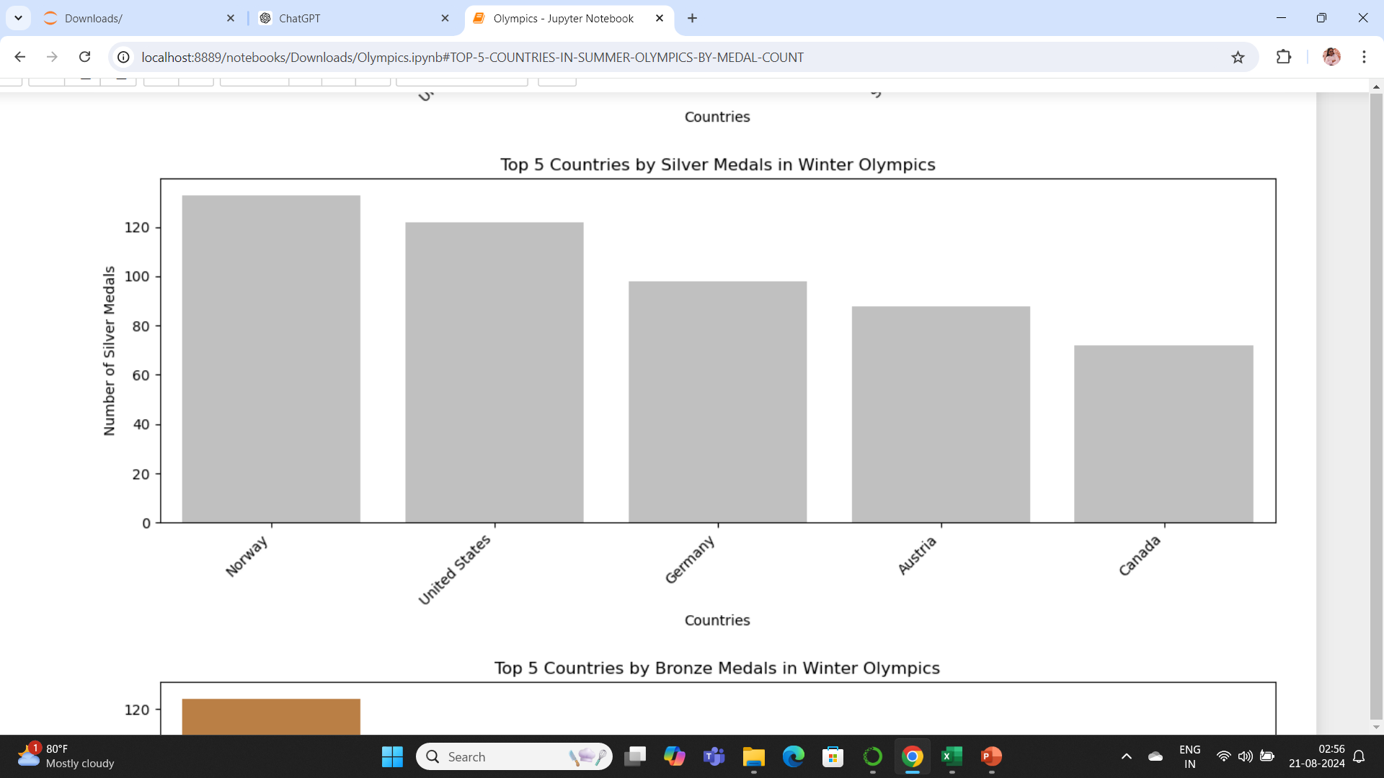

Slide 14
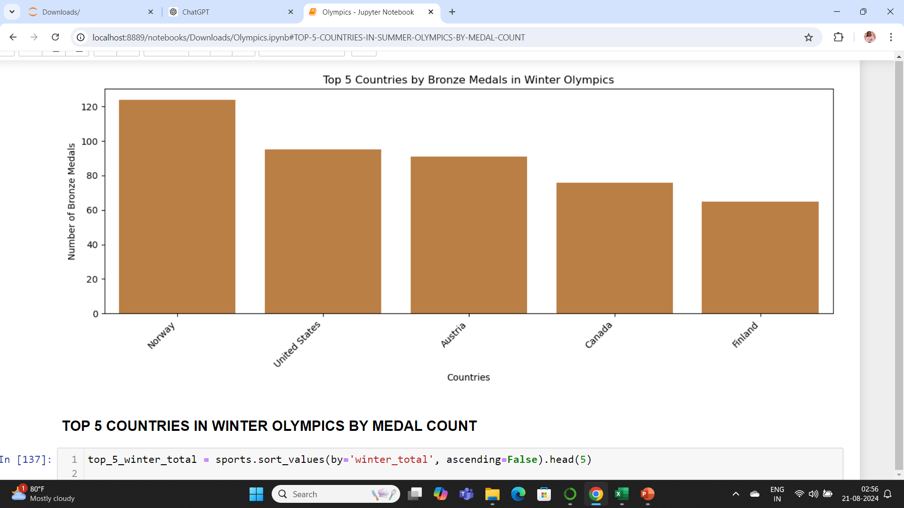

Slide 15
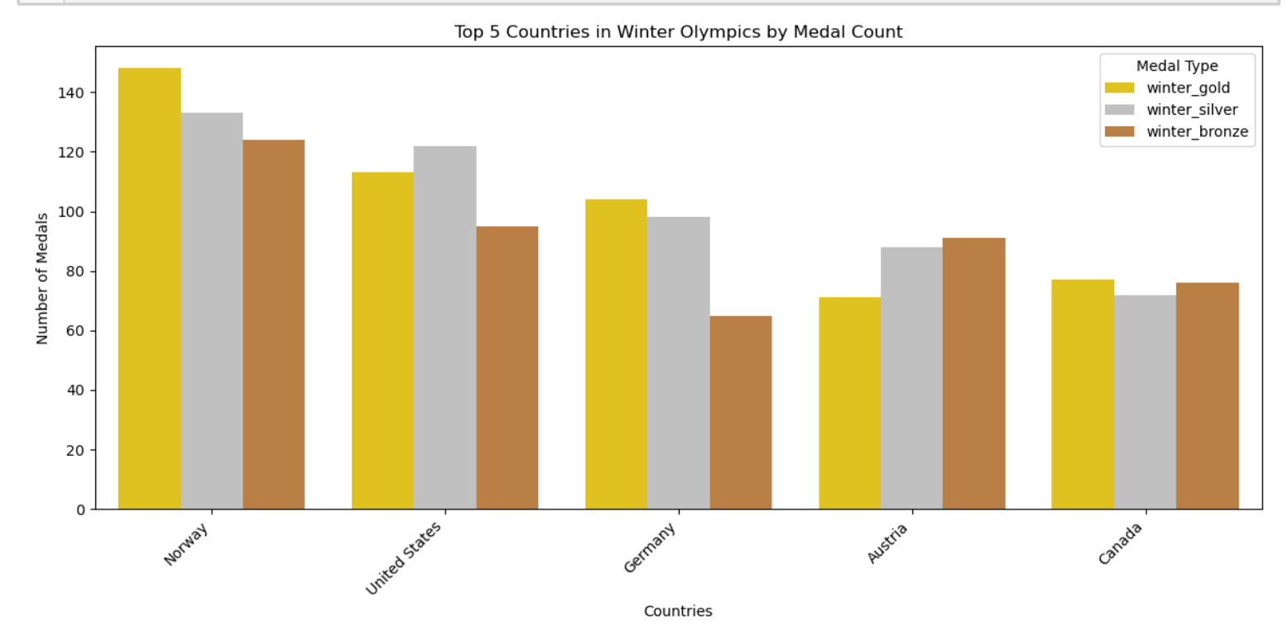
TOP 5 COUNTRIES IN WINTER OLYMPICS

Slide 16
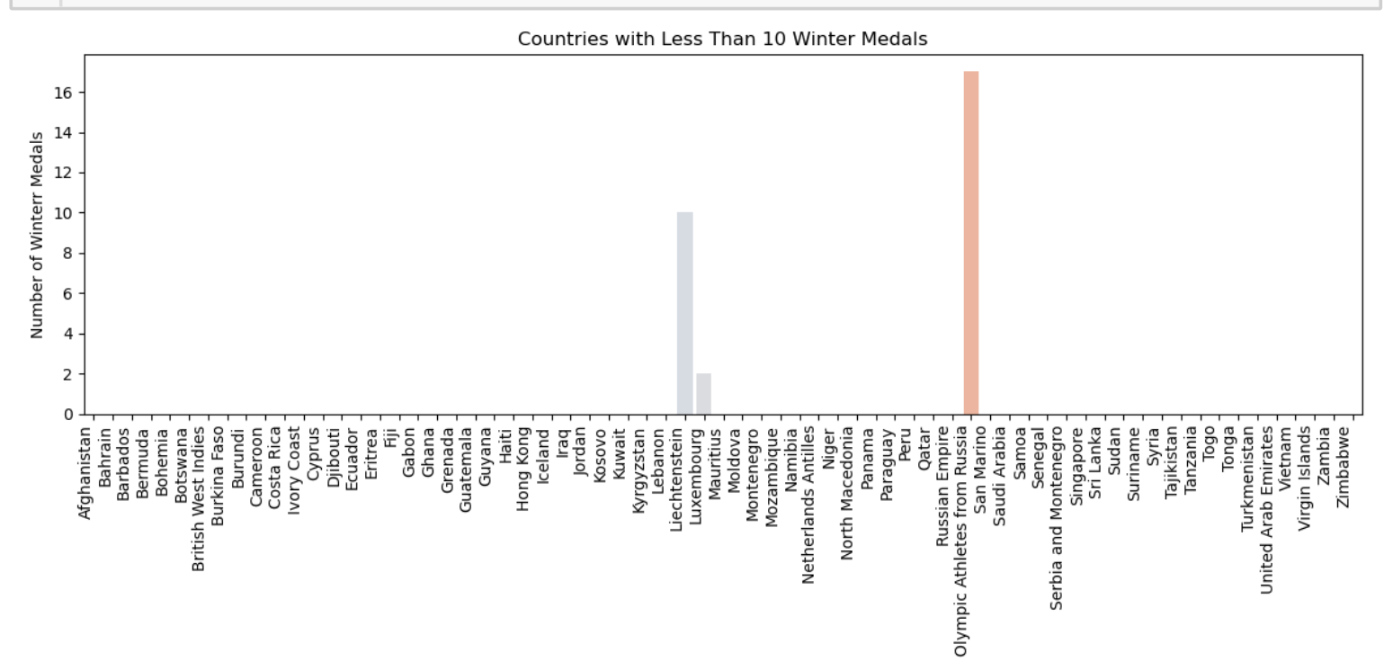
LOW PERFORMING COUNTRIES

Slide 17
OLYMPICS MEDAL COUNTS

Slide 18
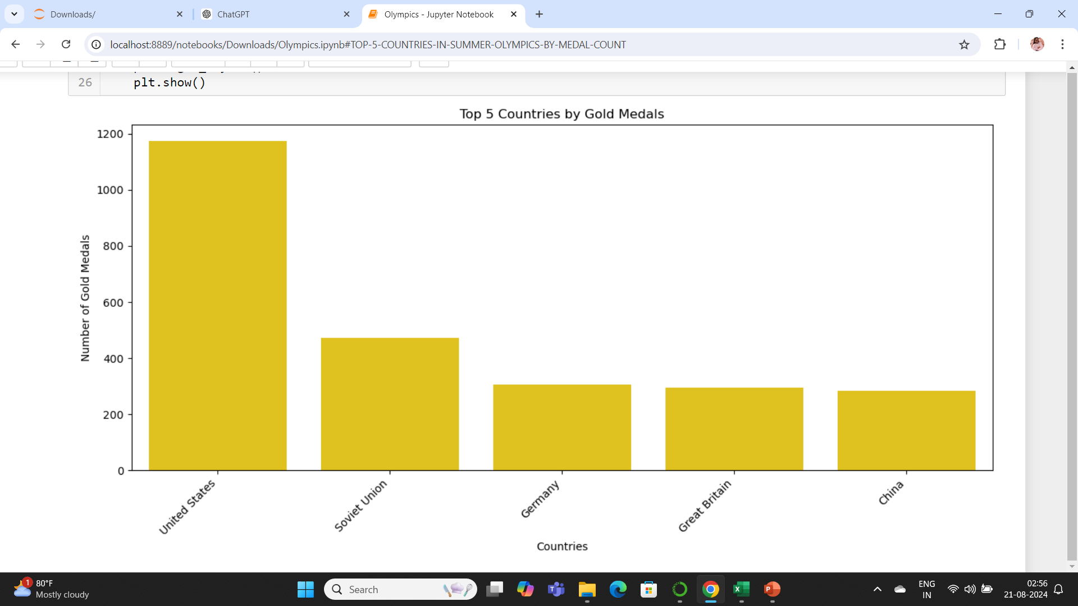

Slide 19
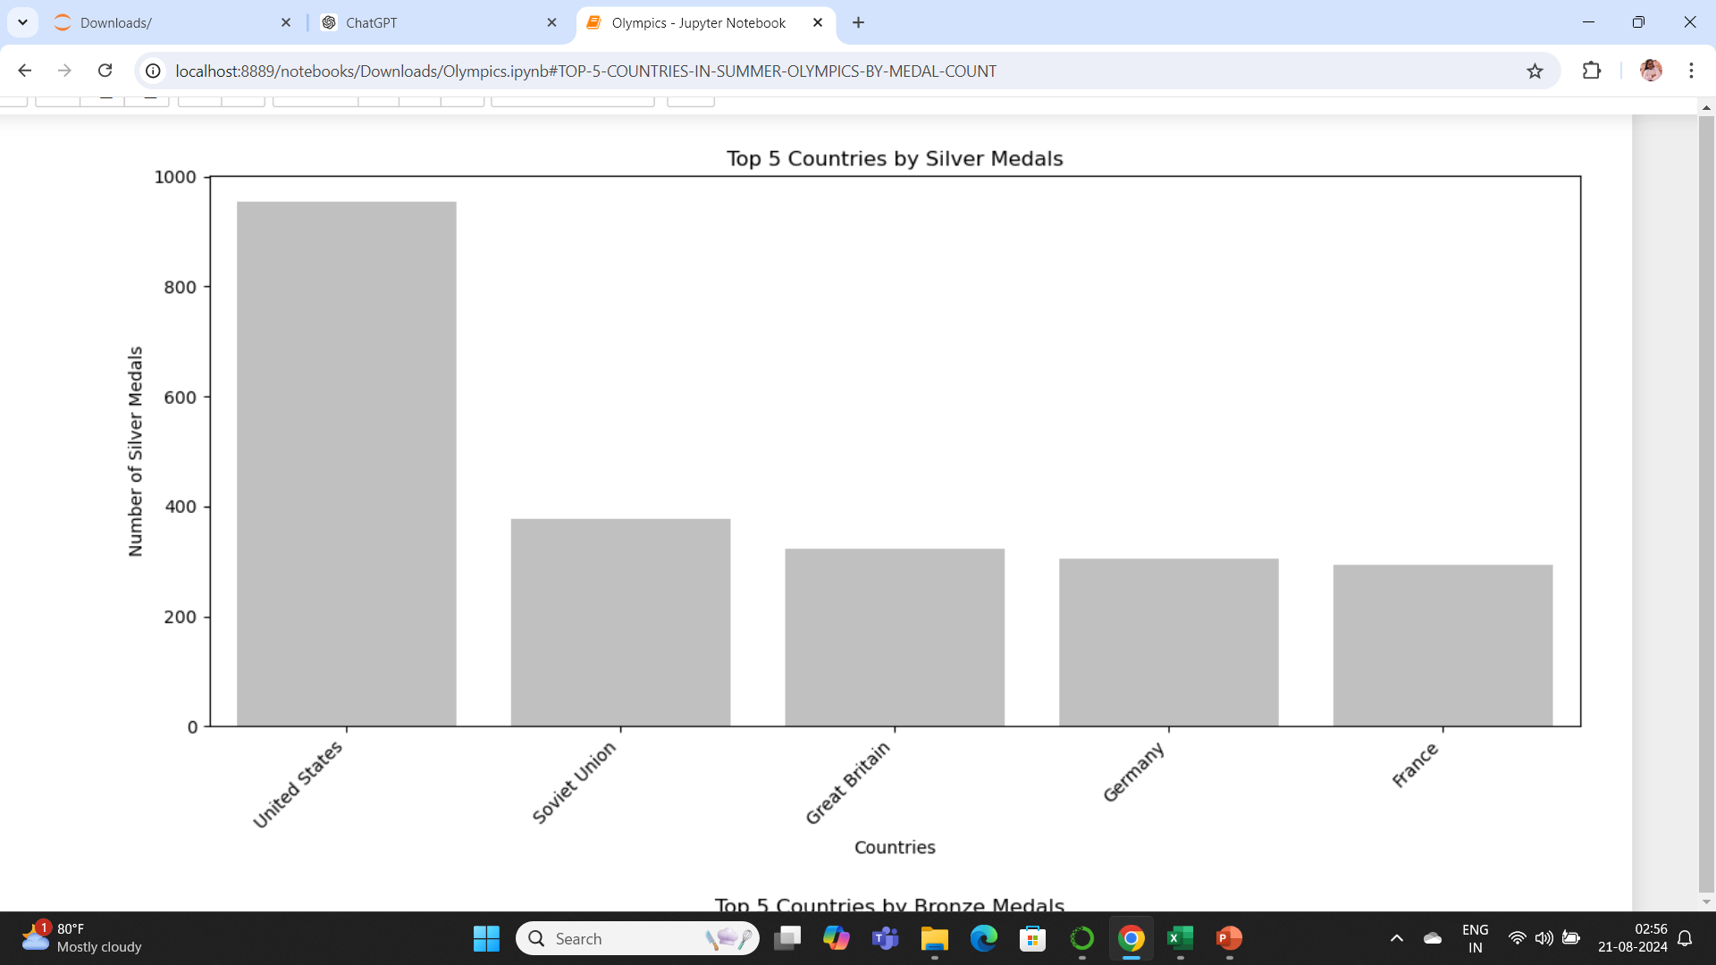

Slide 20
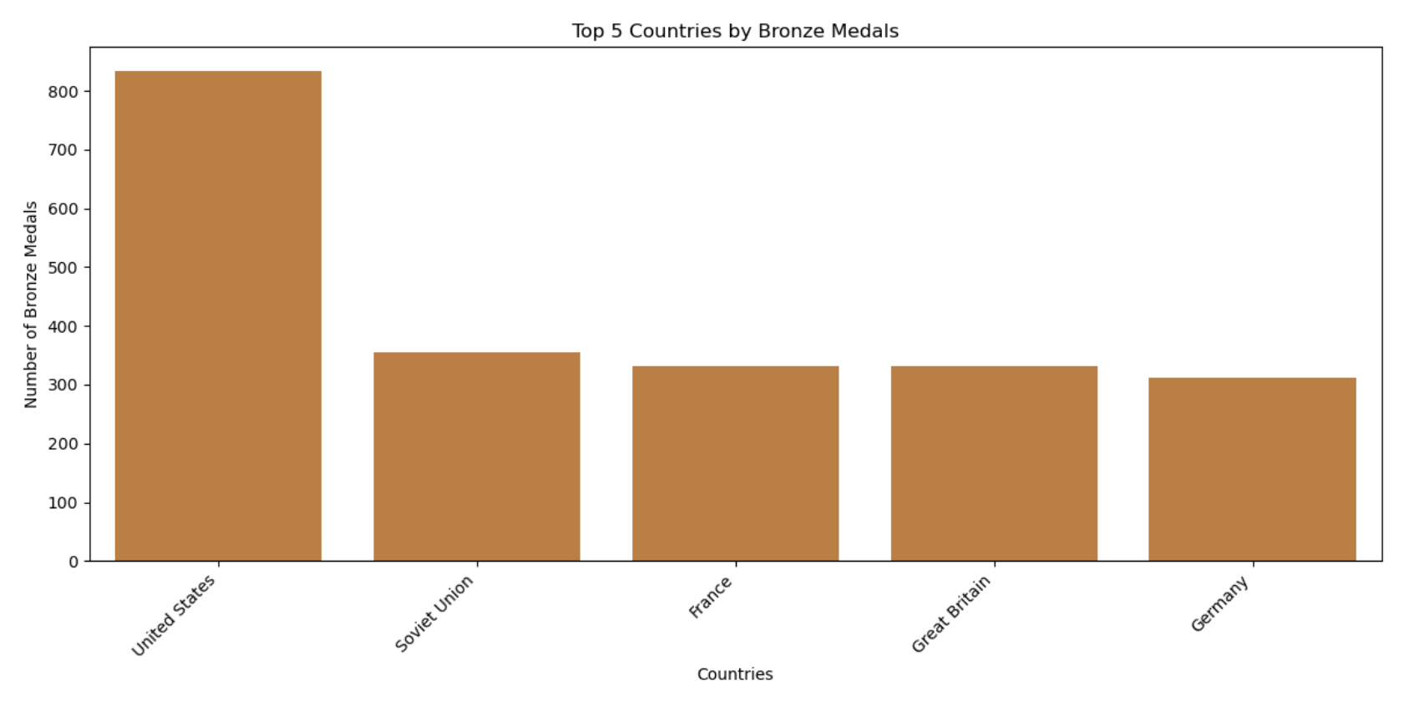

Slide 21
TOP 5 COUNTRIES IN OLYMPICS

Slide 22
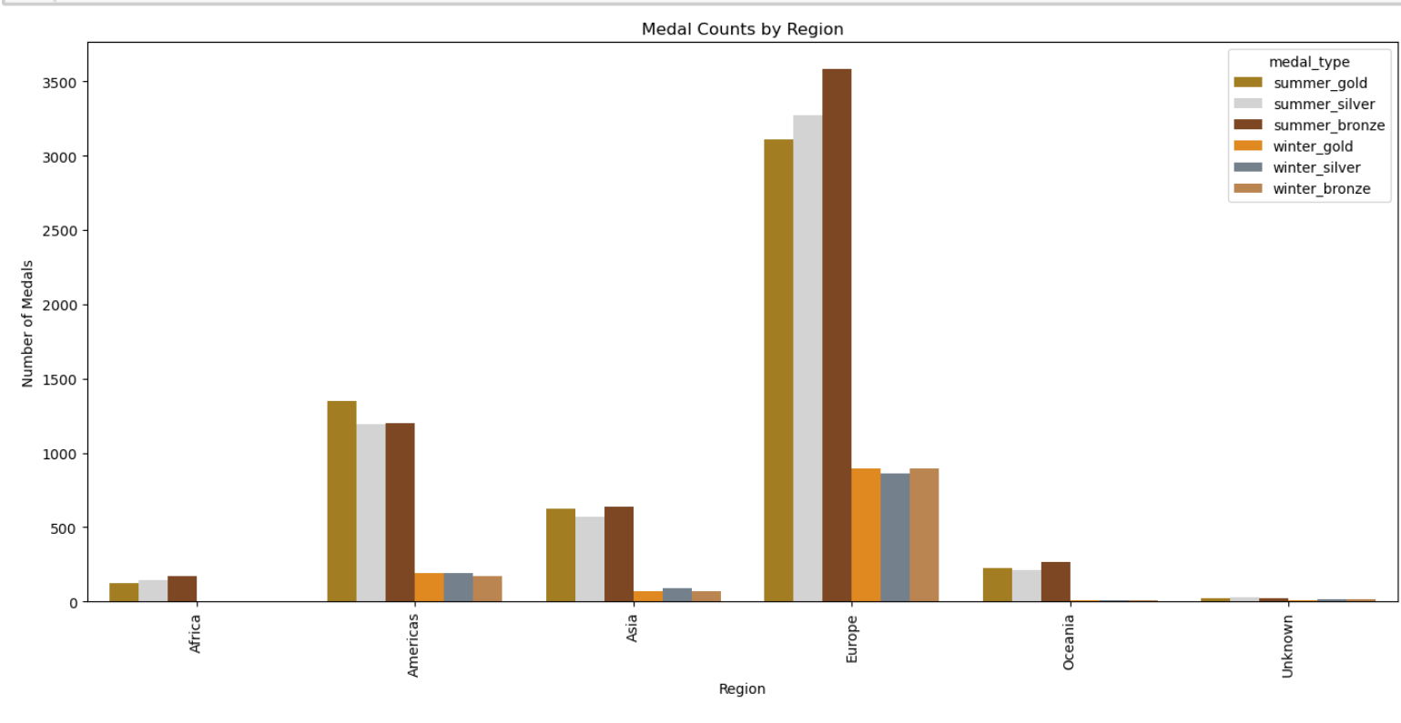
MEDAL COUNTS BY REGION

Slide 23
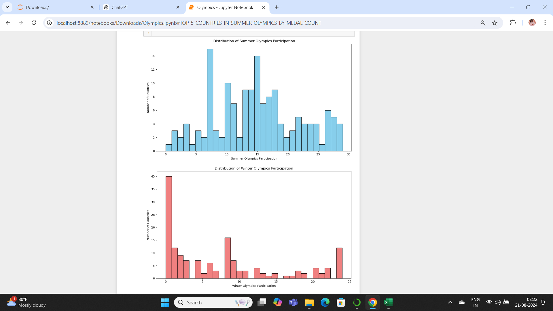

Slide 24
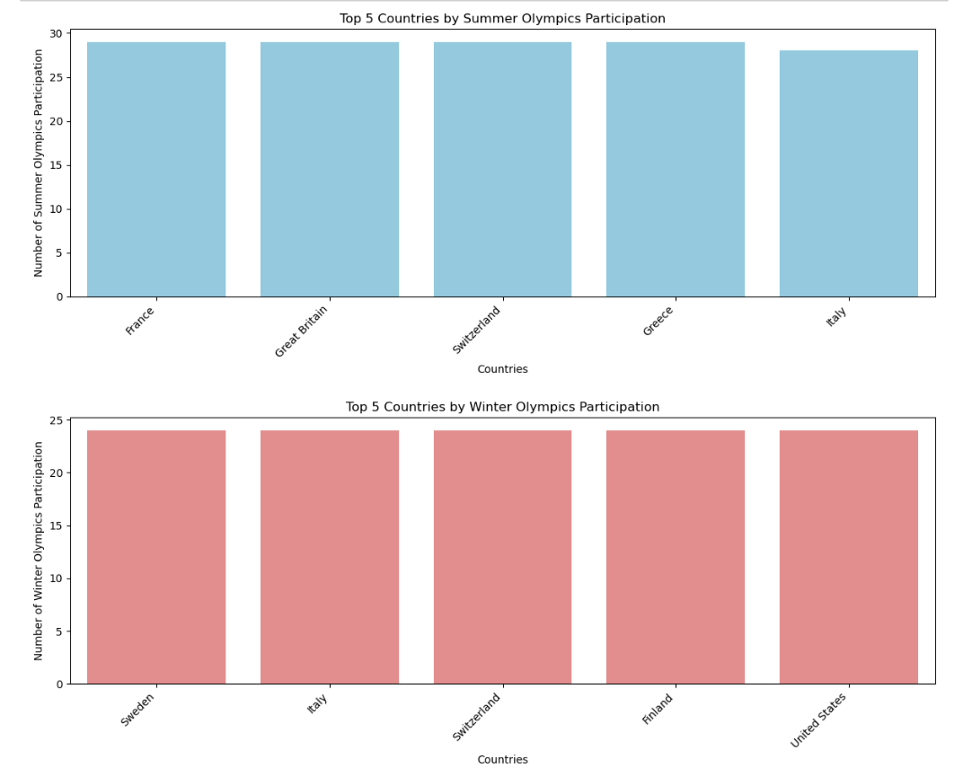
TOP 5 COUNTRIES BY PARTICIPATION

Slide 25
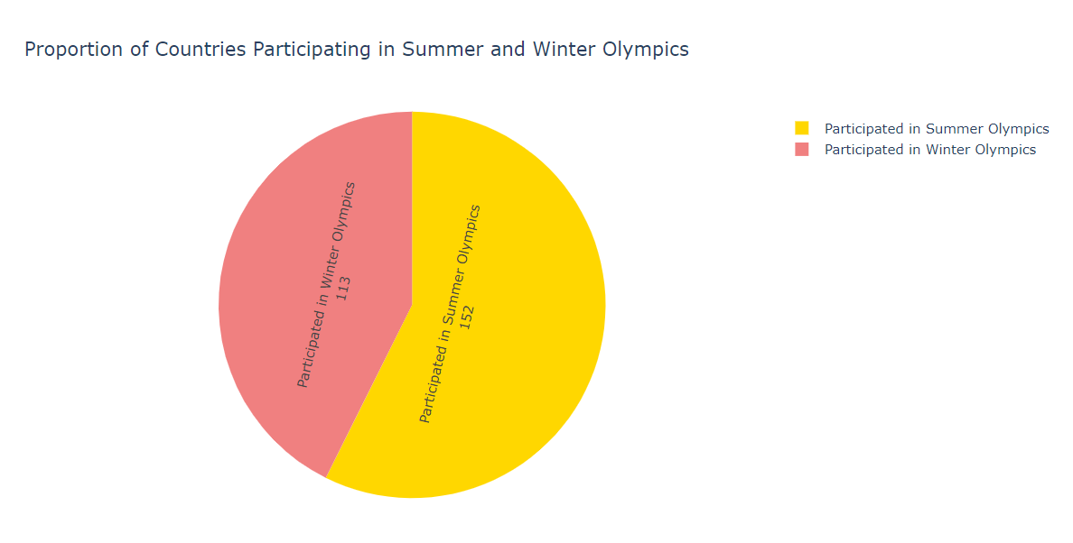
SUMMER/WINTER : PARTICIPANTS

Slide 26
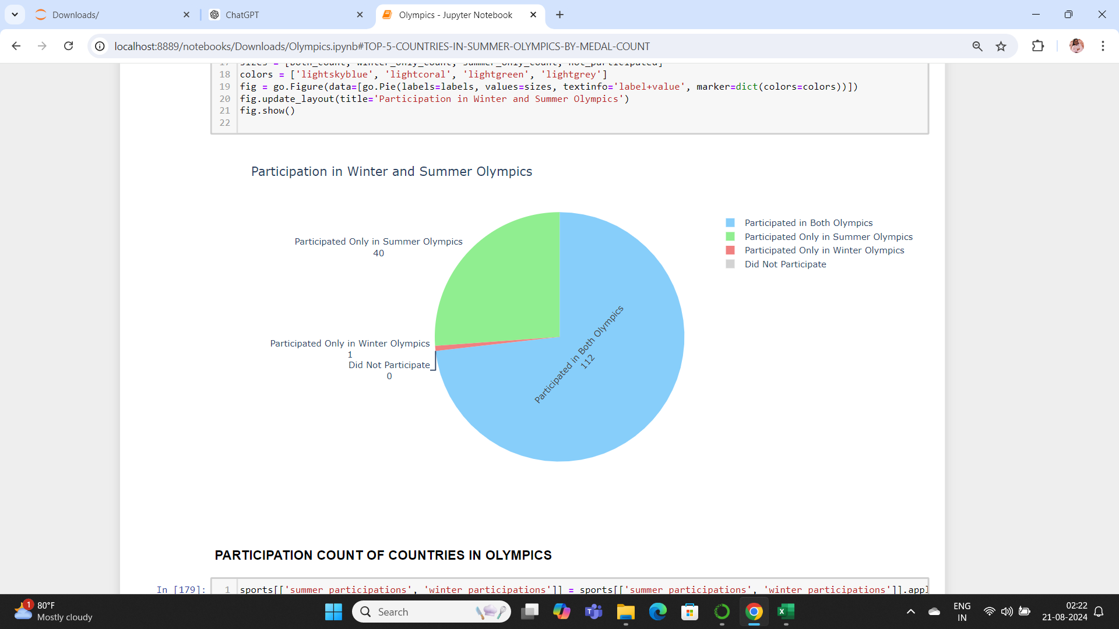

Slide 27
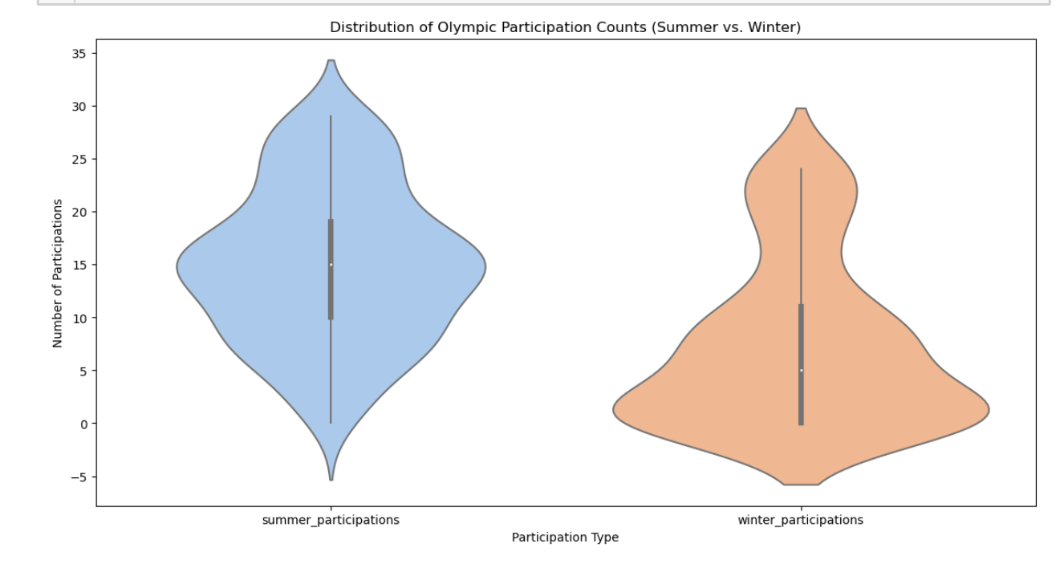
DISTRIBUTION OF PARTICIPATION COUNTS

Slide 28
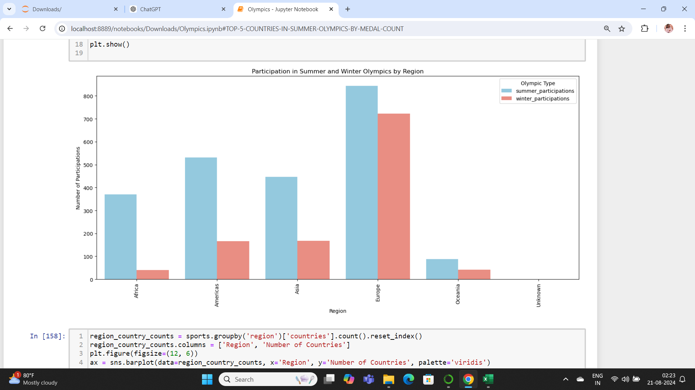
PARTICIPATION COUNTS BY REGION

Slide 29
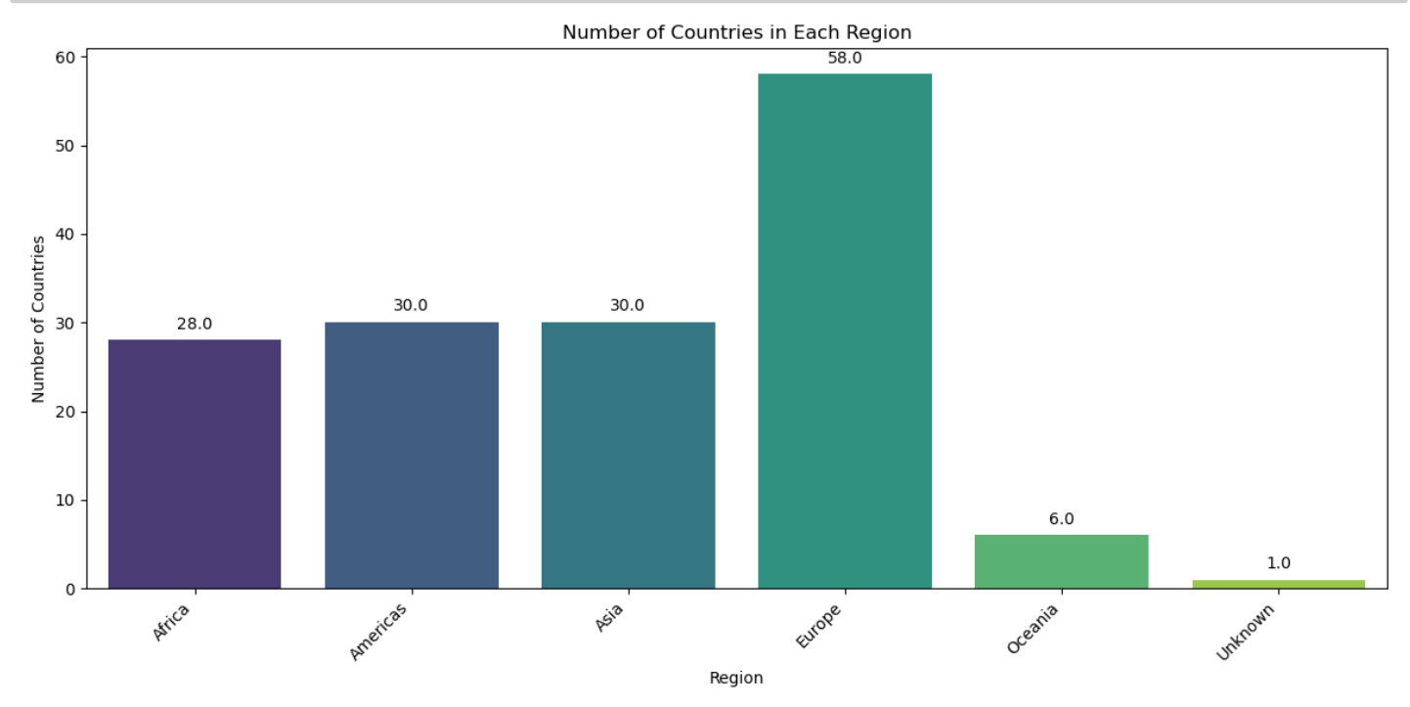
NUMBER OF COUNTRIES IN EACH REGION

Slide 30
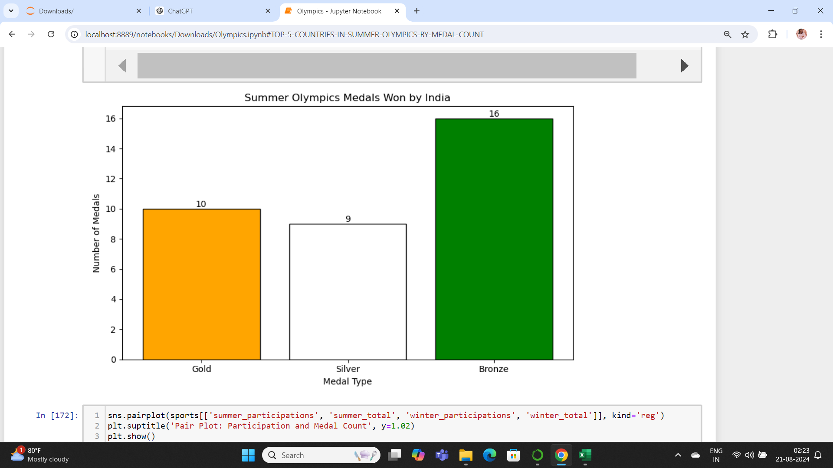
INDIA

Slide 31
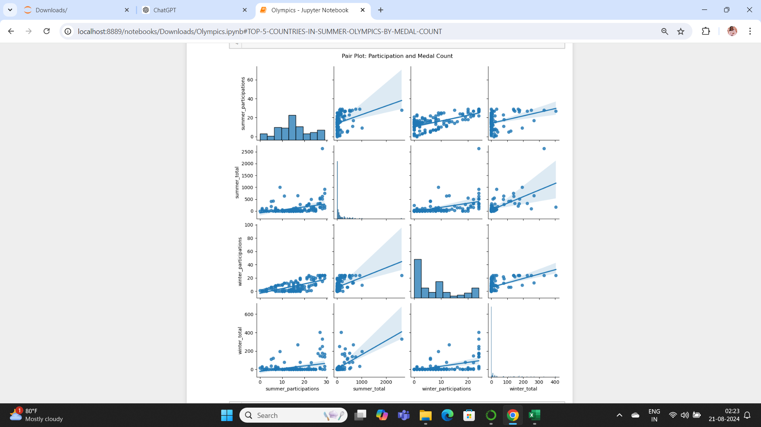

Slide 32
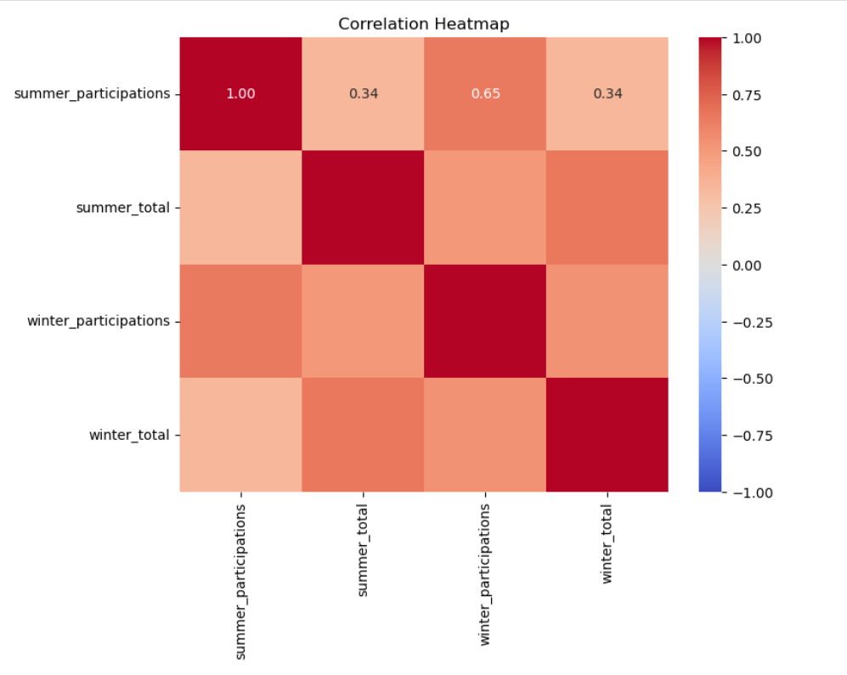

Slide 33
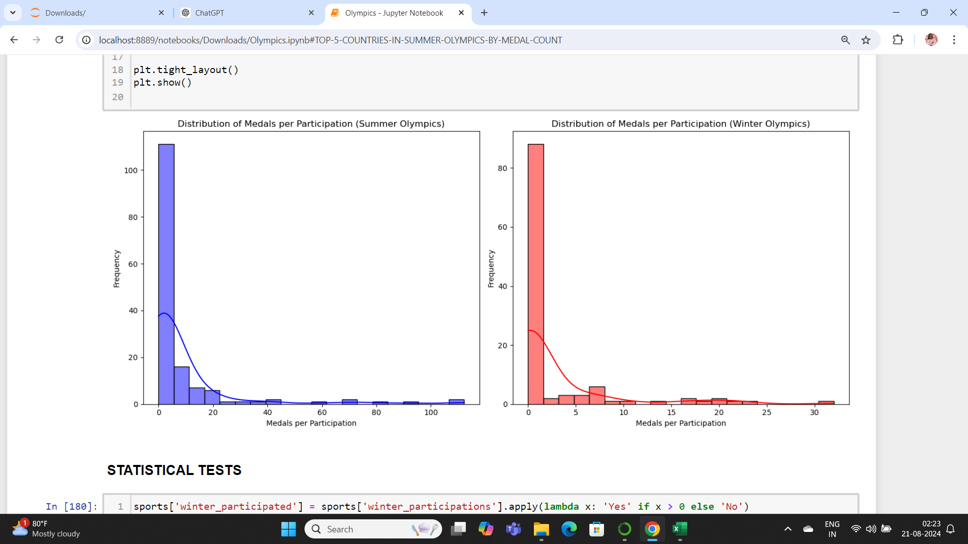
DISTRIBUTION OF MEDALS PER PARTICIPATION

Slide 34
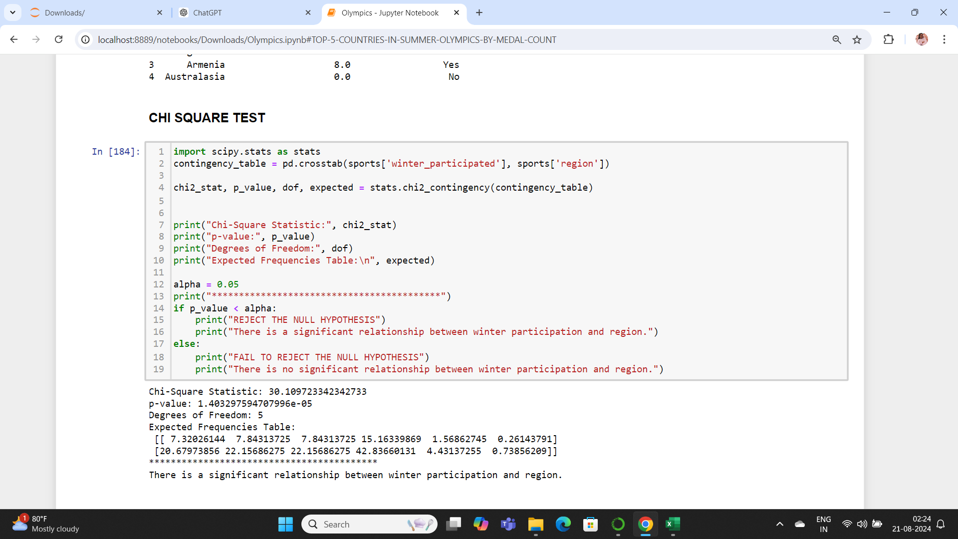
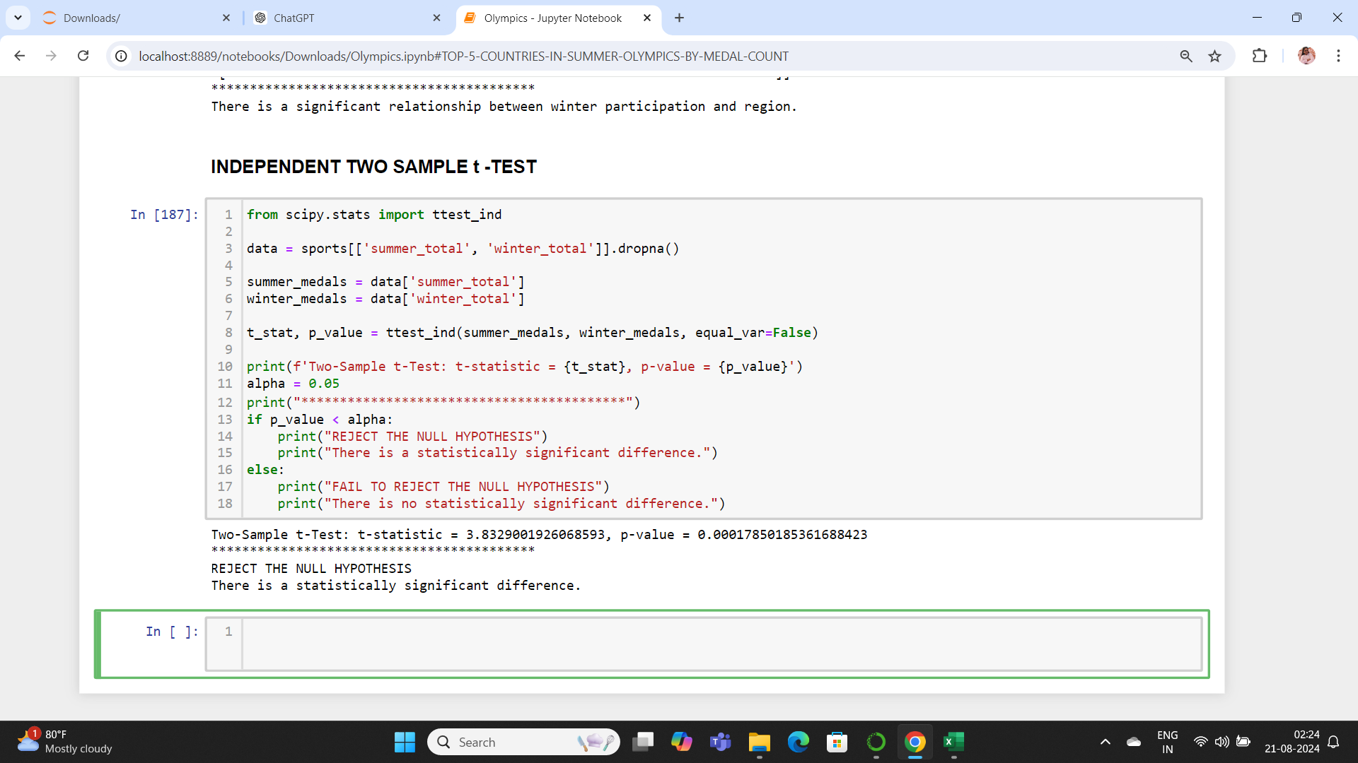
STATISTICAL TESTS

Slide 35


